Slide 1
Parker Quick-Fit
Welcome
Your phone line will be muted during this webinar.
Please enter any questions into the question box.

Slide 2
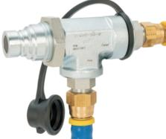
Parker QuickFit™ Oil Change System
Emily Renton
Product Sales Manager
Emily.Renton@parker.com
763-525-4288

Slide 3
Parker Quick Fit
QCD Launched the Quick Fit system January of 2018
RPM has had the concept for 10+ years
Quick Fit website and resources page

Slide 4
Quick Fit Video
Video

Slide 5
Changing engine oil
Variables of oil life
How often and for how long is the engine/equipment running?
Where is it working most?
High or low temperatures
Dirt/dust/debris heavy environments
Quality of oil
What kind of filtration on the engine?
Benefits
Extends engine life
Boosts fuel efficiency
Keeps components cool and reduces wear on components
Remove sludge and debris from critical components

Slide 6
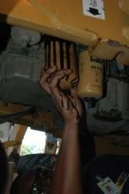
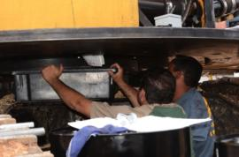
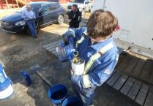
Maintenance Process Today
Slow process
Cramped
Unsafe
Spills
Multiple Personnel
Notes:
6

Slide 7
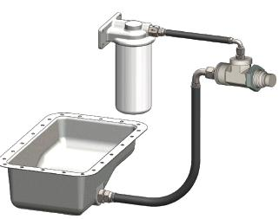
Pressure (+)
Single Service Point
One Process, All Makes
Ground Accessible
Less Process Variability
Easier Service Scheduling
Contamination Control
Environmentally Safe & Clean
Technician Capacity Gains
Single Connection
Positive pressure (+)
Purge & Refill
Suction (−)
Evacuate
S
u
c
t
i
o
n
(-)

Slide 8
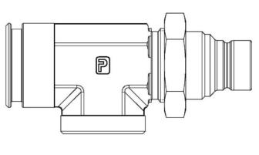
QuickFit Valve
QuickFit Valve
This is the heart of the system
Integrated FEM nipple and double check valve
Provides the single connection point for the entire oil change process
Suction Port
-12 ORB
FEM Nipple
½” ISO 16028
Pressure Port
-10 ORB
CVST-750-5QF

Slide 9
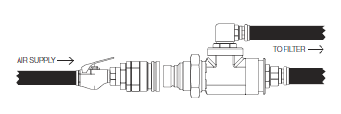
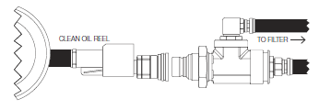
New Oil Change Process
1 Purge Filter
2 Evacuate Oil
3 Refill Oil
Easy as

Slide 10
QuickFit Target Industries

Slide 11
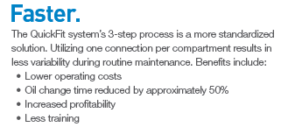
Rental Companies
Up time
Preventative Maintenance
Technician Capacity
Central shop and mobile trucks

Slide 12
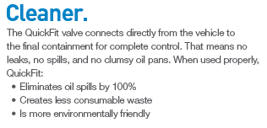
OEMs
Differentiate
Want equipment to be cleaner/environmental concerns
Ease of use for equipment
Notes:
How many times have you had customers complain that a product is faulty and something must be wrong with it, when it is discovered to be user error. OEMs are trying to make things easier to use and operate to reduce customer complaints and issues.

Slide 13
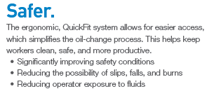
Heavy Equipment
Frequent oil changes
Continuous operation
Preventative maintenance
Control operating costs
Diverse in service environments

Slide 14
Step by Step
Step 1: Once an opportunity for quick fit is identified, take note of the engine make/model
Step 2: Visit the below website
https://parkerquickfit.rpmindustries.com/login.html
Username: ParkerQF
Password: Distributor
Step 3: Download BOM for your make/model
Step 4: build kit, identify which parts come from parker QCD, which come from TFD/HPD and which are things like zip ties or nuts.
Step 5: Get pricing. Quick Fit price list is available, otherwise use QCD.quote@support.parker.com
Step 6: present the solution to your customer, involve your TM for additional value proposition support.

Slide 15
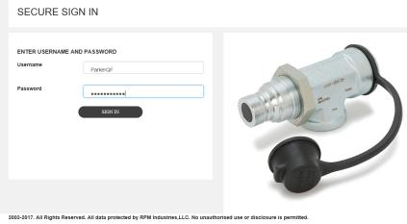
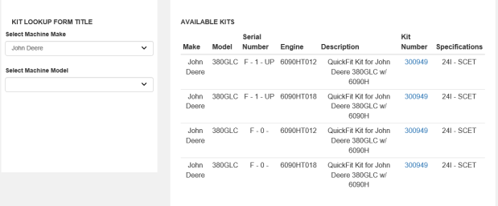
Download Installation Guides

Slide 16
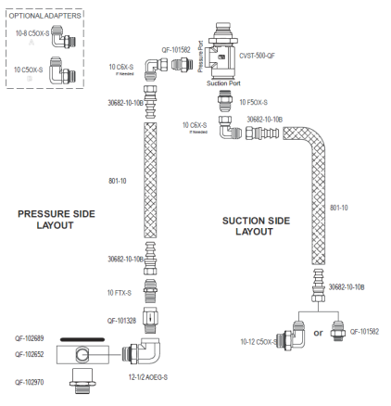
Components in the system
CVST-500-QF
Check Valve
Drain Plug Adapter
Unfiltered Oil Port
Hose and Fittings

Slide 17
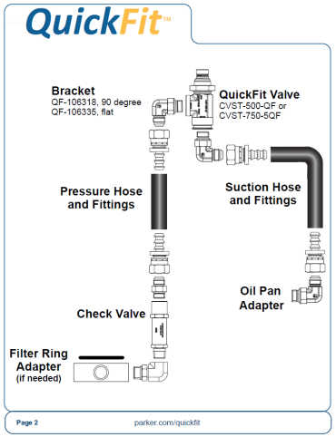
Installation Guide

Slide 18
RESOURCES
QCD Resources Page (quick fit among others)
QuickFit Promo Site

Slide 19
FAQ
“Hi I would like to purchase the quick fit system?”
That’s great, we are happy to help. However much like a hose assembly there is a bit of leg work and application knowledge that is needed. Engine make/model is step 1.
“Hi can I get pricing?”
We can provide pricing on parts that are “QCD” parts, many on the BOM are things from TFD or HPD, some are assigned QF-XXXX part numbers but are really just a zip tie or nut, those would be more easily sourced from your local supply.
“Why isn’t there a kit I can just purchase?”
The Quick Fit system is a system, and doesn’t come in a nicely packaged box ready to plug and play. However with the partnership of our fantastic distributors, your customer can experience just that.

Slide 20
Thank You!
Q&A

